Slide 1

Research Process Part 2
Rachel Reinwald
Fall 2014

Slide 2
Moran, Mark, and Shannon Firth. “A Study of Students Online Research Behavior.” Dulcinea Media, Inc. April 30, 2010.
Notes:
59% of students have performed an internet search before reaching 3rd grade. This shows us that students are utilizing this source, but we need to show them how to do it efficiently, effectively, and safely.

Slide 3
Research Questions / Task Definition
What is my assignment asking me to find out?
What questions do I want to answer?
Notes:
Class can use KWL to brainstorm questions.

Slide 4
Research Keywords
What are keywords?
Why is it important to choose the right keywords?
Notes:
Keywords are the words you use to search for information about a topic.
Why is it important to choose the right keywords? Students should understand that effective keywords produce good search results. To find the information they want, they need to choose their keywords carefully.

Slide 5
What steps can help you choose the best keywords for your searches?
1. First, write one or two sentences about your topic. You can use your research question.
2. Next, underline all of the specific words that describe your topic.
3. Make a separate list of these specific words.
4. Add to your list any other words that mean the same thing (synonyms) or are related terms.
5. Think of more words or phrases that describe the larger topic, of which your topic is a part. Add those to the list. (general / wide search)
6. Think of more words or phrases that are subtopics of your topic which might help you find useful information. Add those to the list. (specific / narrow search)
Cambridge Ringe & Latin School Big 6 Research Guide.
Notes:
1. You can also use a short general encyclopedia article on the topic, read it with the kids, and have them underline keywords.
Lesson: Using Keywords (K-2)
Lesson: The Key to Keywords (3-5)
Lesson: Strategic Searching (6-8) repeat. DO lesson in Search Strategies portion.

Slide 6
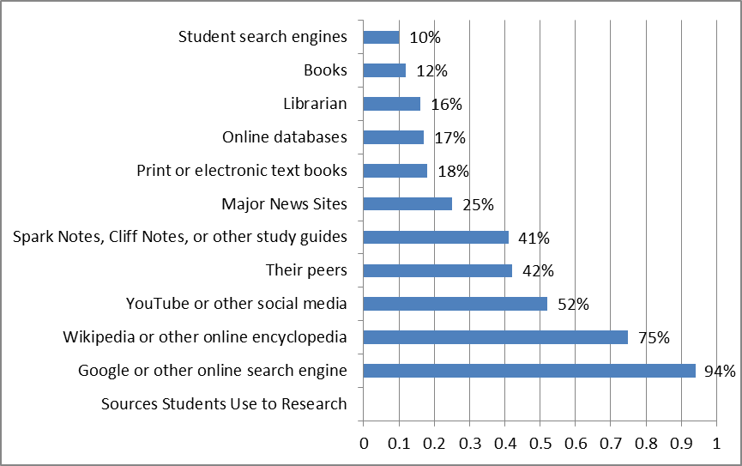
Sources that Teens Use for Researching
Kristen Purcell, Lee Rainie, Alan Heaps, Judy Buchanan, Linda Friedrich, Amanda Jacklin, Clara Chen and Kathryn Zickuhr. “How Teens Do Research in the Digital World.” PEW Research Internet Project. Nov. 1, 2012.
Notes:
If you have a class of 22:
3 will use books
4 will use databases
5 will use the news
BUT
21 will use Google
17 will use Wikipedia
11 will use Social Media
9 will ask their friends
9 will use Cliff Notes, Spark Notes, Study guides

Slide 7
Moran, Mark, and Shannon Firth. “A Study of Students Online Research Behavior.” Dulcinea Media, Inc. April 30, 2010.
Notes:
The problem with this is all of the sites are search engines, except Yahoo which is a directory. There are no indices or meta search engines, so you’re only getting results from their algorithm and sites. Wikipedia is an encyclopedia, however the answers are crowd sourced and it could take some time to correct errors (this site would have to be fact-checked, which takes longer).
In a class of 22:
20 will use search engines
0 will use the library, the school or databases
0 will use encyclopedias other than 1 using Wikipedia
2 have no idea

Slide 8
Choosing a Search Site
Search engine: a site that uses computer programs to search for information on the Web
Index: a place where information is stored and organized
Directory: a site that uses people to search the Web and put together information on different subjects
Meta-search engine: a site that sends inputted keywords to several different search engines at the same time
Notes:
6-8 Crawling the Web (3 types of search sites) PRINT p. 8-9
3-5 Choosing a Search Site (homepage, search results, features) PRINT p. 5-6

Slide 9
Moran, Mark, and Shannon Firth. “A Study of Students Online Research Behavior.” Dulcinea Media, Inc. April 30, 2010.
Notes:
Typing a question is known as using “natural language.”
2 kids in your class (of 22) are searching efficiently and effectively.

Slide 10
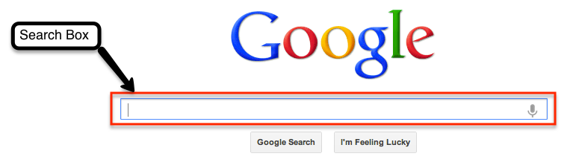
Search Strategies
Brainstorm keywords
Words to eliminate (NOT words) Ex: Dolphins NOT football
Understand syntax or the language of the search engine (help or tips page tells you HOW to search)
Put most important words first
Search nouns first
Phrases in “quotes” Ex: “Martin Luther King”
Don’t include articles (“a,” “an,” “the” are most often ignored by search engines)
Use connectors (AND, OR)
Herring, James A. “Figure 6.4 How to Structure a Good Search Engine Query.” (p. 82) Improving Students’ Web Use and Information Literacy. Facet Publishing, London. 2011.

Slide 11
Porterfield, Jason. Conducting Basic and Advanced Searches.
Notes:
Lesson: The Key to Keywords (3-5) repeat, don’t do again, just mention
Lesson: Strategic Searching (6-8)
Younger: demonstrate
How do desert animals adapt to their environment?
www.dogpile.com
Desert animal adaptations
- Greenwich Public Schools: http://www.greenwichschools.org/page.cfm?p=5173#DESERT
- Woodlands Jr High Teacher Hmwk guide: http://resources.woodlands-junior.kent.sch.uk/homework/adaptations/desert.htm
http://www.enchantedlearning.com/biomes/desert/desert.shtml
http://www.desertanimals.net/
http://www.desertmuseum.org/center/edu/docs/4-12_ex_adapt_postvisit.pdf

Slide 12
Moran, Mark, and Shannon Firth. “A Study of Students Online Research Behavior.” Dulcinea Media, Inc. April 30, 2010.
Notes:
Only 7% of students are using web evaluation strategies effectively. And this is at the middle school level. Even less know how to evaluate a source at the elementary age.

Slide 13
Moran, Mark, and Shannon Firth. “A Study of Students Online Research Behavior.” Dulcinea Media, Inc. April 30, 2010.
Notes:
This is a web evaluation strategy called Authority, where you look at the author’s credentials and why they are an expect on that topic. Who would write a better article on chimps…. Jane Goodall or your little brother? 72% of students are not worried about who wrote the article. Notice there isn’t a category for “all the time.”

Slide 14
Evaluating Websites
Authority / Credentials
Accuracy
Relevancy
Currency
Reliability / Bias
Notes:
Teachers were confused about why sources had differing information on the last eruption of Mt. St. Helena. One group was using a book from 2001, when the volcano had last erupted in 2008. And they had not checked the copyright. Kids do this ALL THE TIME.
CREDO: “Over 50% of students defined information literacy as it relates to using, finding and evaluating information, but 46.4% look for a copyright symbol to determine accuracy [currency] of a source.”
“Professor Ebersole, chairman of the mass- communications department at the University of Southern Colorado, collected more than 130,000
Web addresses used by Colorado middle- and high- school students who claimed to be using the Internet for research. With the help of two media experts, he reviewed a random sample of 500 of these sites to determine their reliability for academic research. The result: an astonishingly low 27 percent of the sites were considered reliable sources of information.” (csmonitor.com/2000/0425/p16s1.html)
Show good website that hits all the marks and then a bad website??
Lesson: Rating Websites (3-5)
Lesson: Identifying High Quality Sites (6-8)

Slide 15
“97% of students can define plagiarism but […] 74% of students admit to violating their school’s academic integrity policy at least once.”
CREDO Information Literacy Survey in association with Librariesthriving.org
Notes:
In our last CPDU, 16% plagiarized when the class realized that one of the details they needed to argue in support of, or deny as an essential detail, was the SAME as the GIST or Summary of that paragraph written by a group. The group had merely copied the sentence. Kids do this a lot either because they don’t realize it, they don’t have the skills to summarize, or they don’t feel like doing the work. We as teachers can fix 2/3 of that problem.

Slide 16
Plagiarism
Plagiarism is when you use someone else's words or ideas and pass them off as your own.
You should give the author and the source credit for the information. Why? Because you didn't know this information before you read this source. These aren't your thoughts or ideas.
Notes:
Lesson: Whose Is It Anyway (3-5)
Lesson: Creators Rights (6-8)

Slide 17
Summarize, Paraphrase, Quote
Summary: Telling the main idea(s) in less words without writing the same thing as the text. Use when there is a lot of information to talk about.
Paraphrase: About the same length, includes main points, but they are rephrased, using different words and in different order. Use when you can rephrase better to show your point.
Quote: Using the exact same words (usually just a sentence) and putting quotation marks around the sentence to show that they are not your words. Use when there is no way you could phrase better or when you are showing statistics.
All summaries, paraphrases and quotes should have a citation at the end of the sentence, because they are not your ideas.
Notes:
If you want kids to practice, write quotes from an article on index cards. Have kids do a relay race word sort to decide whether that sentence should be summarized or quoted.
Paraphrase: http://www.d214.org/district_library/paraphrase_example.aspx

Slide 18
Double Entry Journal
Forces students to analyze information.
Shows the quote that they are summarizing or paraphrases.
Asks students to say something significant about the information instead of just repeating it.
Prospect High School (IL) DEJ form from school library website
Notes:
With older kids, I do Double Entry Journals, where they put the quote on one side, and their summary and analysis on the other side. (If it’s a quote, just analysis)

Slide 19
Citing Sources
A list of cited sources is called a bibliography. If you have more advanced students, include an in-text citations lesson.
We make a bibliography to show where we got information that we didn’t make up ourselves. This helps us avoid plagiarism.
Handbooks prescribed by your school
Purdue Online Writing Lab MLA Formatting Guide: https://owl.english.purdue.edu/owl/resource/747/01
Databases at the bottom of the article
EasyBib: http://www.easybib.com/
Citation Machine: http://www.citationmachine.net/mla/cite-a-book
Bib Me: http://www.bibme.org/
Notes:
Most databases have a place on each article where it shows you how to cite that article (either a button or at the end of the article).
Lesson: How to Cite a Site (3-5) *only shows website sources
Lesson: Notefacts (K-8) LATER in Outlining

Slide 20
Outlining: Why?
Helps you organize your ideas
Presents your material in a logical form
Shows the relationships among ideas in your writing
Constructs an ordered overview of your writing
Defines boundaries and groups
Taken directly from Purdue Online Writing Lab

Slide 21
Outlining: How?
Brainstorm: List all the ideas that you want to include.
Organize: Group related ideas together.
Order: Arrange material in each group from general to specific.
Label: Create main and sub headings.
Taken directly from Purdue Online Writing Lab

Slide 22
Notefacts
Each source is assigned a number and placed in magnifying glass.
Notefacts are short (notes) and true (facts).
Documents sources and records original notes.
Students can then color code their fact strips by subject.
Match colors at the end to make an outline.
Notes:
Lesson: Notefacts (K-8)
Notefacts comes from the research process, the Independent Investigation Method (IIM), that starts out easy for 1st grade and gets progressively harder up to 12th grade.
Ex: All notes about my book are in source #1 in mag glass icons. One note per strip.
RED = where they live
GREEN = what they eat
YELLOW = interesting facts
ORANGE = crafts/culture/arts
BLUE = housing

